Slide 1



How to find the index in collection
What is hint () in index
How to use hint ()
how to determine an index for an collection(senories to consider)

Slide 2
Aggregation

Slide 3
Aggregation Introduction
Aggregations are operations that process data records and return computed results.
MongoDB provides a rich set of aggregation operations that examine and perform calculations on the data sets.
Like sql queries, aggregation operations in MongoDB use collections of documents as an input and return results in the form of one or more documents.

Slide 4

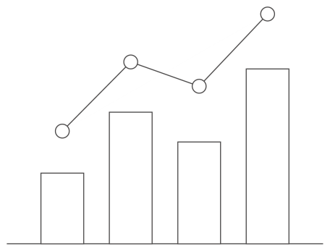


Analytics in MongoDB?
Analytics
?
Create
Read
Update
Delete
Group
Count
Derive Values
Filter
Average
Sort

Slide 5
Aggregation Types
Map-Reduce
Pipelines Aggregation
Single Purpose Aggregation Operations.

Slide 6
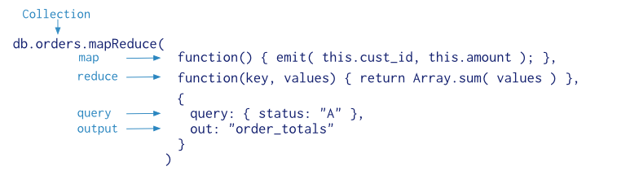
Map-Reduce
Map-reduce is a data processing paradigm for condensing large volumes of data into useful aggregated results.
For map-reduce operations, MongoDB provides the mapReduce database command.

Slide 7
Map-Reduce
MongoDB applies the map phase to each input document (i.e. the documents in the collection that match the query condition). The map function emits key-value pairs.
For those keys that have multiple values, MongoDB applies the reduce phase, which collects and condenses the aggregated data.
MongoDB then stores the results in a collection.

Slide 8
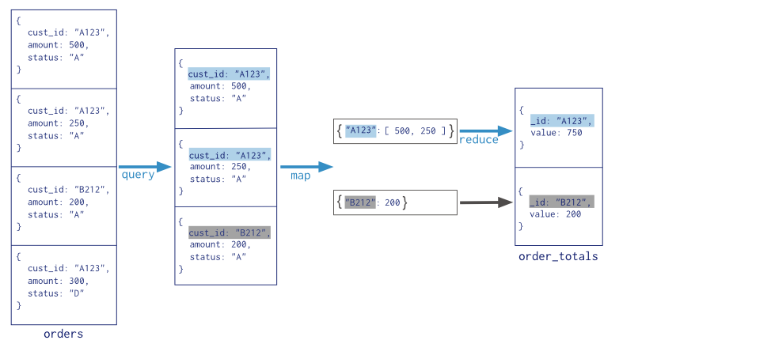
Map-Reduce

Slide 9
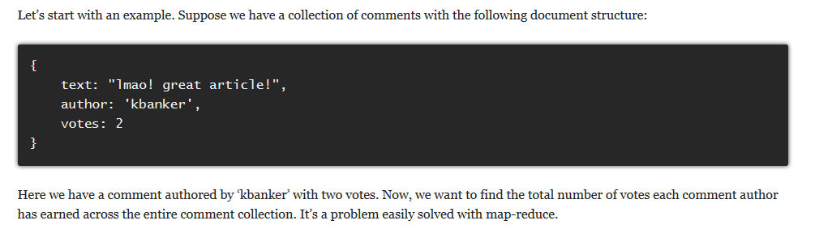
Map-Reduce Examples

Slide 10
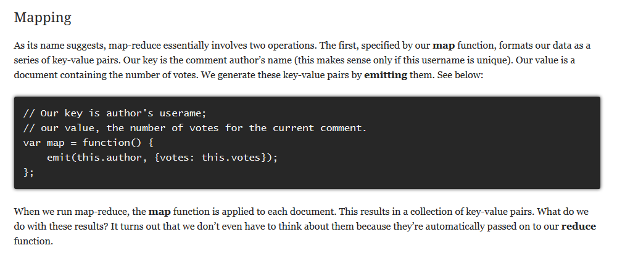
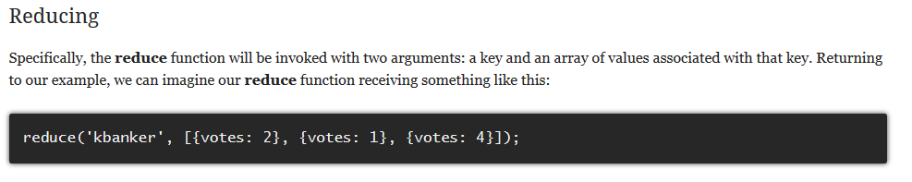
Solution

Slide 11
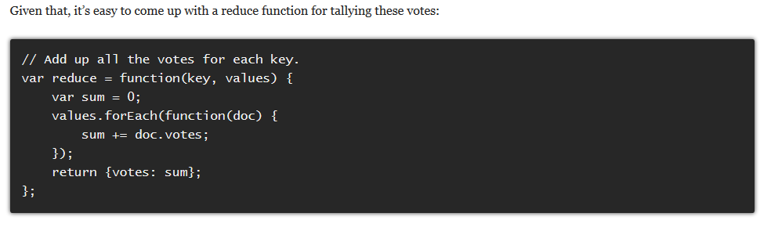
Solution

Slide 12
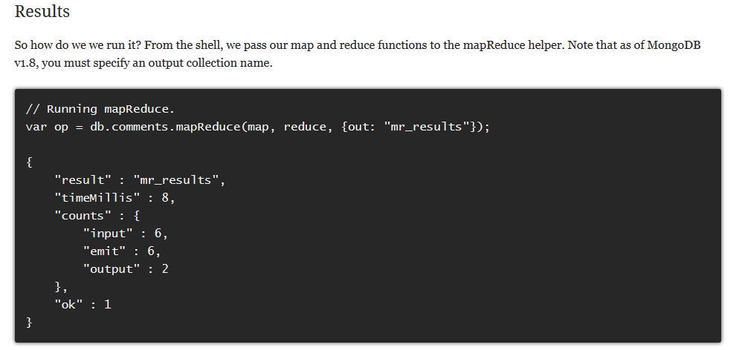
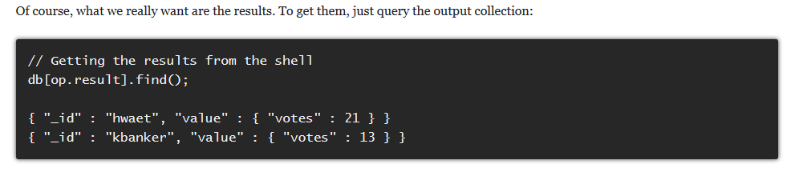

Slide 13

What is an Aggregation Pipeline?
A Series of Document Transformations
  Executed in stages
  Original input is a collection
  Output as a document, cursor or a collection
Rich Library of Functions
  Filter, compute, group, and summarize data
  Output of one stage sent to input of next
  Operations executed in sequential order

Slide 14
Pipeline Operators
$match
  Filter documents
$project
  Reshape documents
$group
  Summarize documents
$unwind
  Expand documents
$sort
  Order documents
$limit / $skip
  Paginate documents
$redact
  Restrict documents
$geoNear
  Proximity sort documents
$let, $map
  Subexpression variables

Slide 15
Our Example Data
{
_id: 375,
title: "The Great Gatsby",
ISBN: "9781857150193",
available: true,
pages: 218,
chapters: 9,
subjects: [
"Long Island",
"New York",
"1920s"
],
language: "English"
}

Slide 16


$match
Filter documents
  Uses existing query syntax
  Can facilitate shard exclusion
  No $where (server side Javascript)

Slide 17
Matching Field Values
{
title: "The Great Gatsby",
pages: 218,
language: "English"
}
{ $match: {
language: "Russian"
}}
{
title: "War and Peace",
pages: 1440,
language: "Russian"
}
{
title: "War and Peace",
pages: 1440,
language: "Russian"
}
{
title: "Atlas Shrugged",
pages: 1088,
language: "English"
}

Slide 18
Matching with Query Operators
{
title: "The Great Gatsby",
pages: 218,
language: "English"
}
{ $match: {
pages: {$gt:100}
}}
{
title: "War and Peace",
pages: 1440,
language: "Russian"
}
{
title: "War and Peace",
pages: 1440,
language: "Russian"
}
{
title: "Atlas Shrugged",
pages: 1088,
language: "English"
}
{
title: ”Atlas Shrugged",
pages: 1088,
language: “English"
}

Slide 19

$project
Reshape Documents
  Include, exclude or rename fields
  Inject computed fields
  Create sub-document fields

Slide 20
Including and Excluding Fields
{
_id: 375,
title: "Great Gatsby",
ISBN: "9781857150193",
available: true,
pages: 218,
subjects: [
"Long Island",
"New York",
"1920s"
],
language: "English"
}
{ $project: {
_id: 0,
title: 1,
language: 1
}}
{
title: "Great Gatsby",
language: "English"
}

Slide 21
Renaming and Computing Fields
{
_id: 375,
title: "Great Gatsby",
ISBN: "9781857150193",
available: true,
pages: 218,
chapters: 9,
subjects: [
"Long Island",
"New York",
"1920s"
],
language: "English"
}
{ $project: {
avgChapterLength: {
$divide: ["$pages",
"$chapters"]
},
lang: "$language"
}}
{
_id: 375,
avgChapterLength: 24.2222,
lang: "English"
}

Slide 22
Creating Sub-Document Fields
{
_id: 375,
title: "Great Gatsby",
ISBN: "9781857150193",
available: true,
pages: 218,
chapters: 9,
subjects: [
"Long Island",
"New York",
"1920s"
],
language: "English"
}
{ $project: {
title: 1,
stats: {
pages: "$pages",
language: "$language",
}
}}
{
_id: 375,
title: "Great Gatsby",
stats: {
pages: 218,
language: "English"
}
}

Slide 23

$group
Group documents by value
  Field reference, object, constant
  Other output fields are computed
    $max, $min, $avg, $sum
    $addToSet, $push
    $first, $last
  Processes all data in memory by default

Slide 24
Calculating An Average
{
title: "The Great Gatsby",
pages: 218,
language: "English"
}
{ $group: {
_id: "$language",
avgPages: { $avg:
"$pages" }
}}
{
title: "War and Peace",
pages: 1440,
language: "Russian"
}
{
_id: "Russian",
avgPages: 1440
}
{
title: "Atlas Shrugged",
pages: 1088,
language: "English"
}
{
_id: "English",
avgPages: 653
}

Slide 25
Summing Fields and Counting
{
title: "The Great Gatsby",
pages: 218,
language: "English"
}
{ $group: {
_id: "$language",
pages: { $sum: "$pages" },
books: { $sum: 1 }
}}
{
title: "War and Peace",
pages: 1440,
language: "Russian"
}
{
_id: "Russian",
pages: 1440,
books: 1
}
{
title: "Atlas Shrugged",
pages: 1088,
language: "English"
}
{
_id: "English",
pages: 1316,
books: 2
}

Slide 26
Collecting Distinct Values
{
title: "The Great Gatsby",
pages: 218,
language: "English"
}
{ $group: {
_id: "$language",
titles: { $addToSet: "$title" }
}}
{
title: "War and Peace",
pages: 1440,
language: "Russian"
}
{
_id: "Russian",
titles: [“War and Peace”]
}
{
_id: "English",
titles: [
"Atlas Shrugged",
"The Great Gatsby” ]
}
{
title: "Atlas Shrugged",
pages: 1088,
language: "English"
}

Slide 27


$unwind
Operate on an array field
  Create documents from array elements
    Array replaced by element value
    Missing/empty fields → no output
    Non-array fields → error
  Pipe to $group to aggregate

Slide 28
Collecting Distinct Values
{
title: "The Great Gatsby",
ISBN: "9781857150193",
subjects: [
"Long Island",
"New York",
"1920s"
]
}
{ $unwind: "$subjects" }
{ title: "The Great Gatsby",
ISBN: "9781857150193",
subjects: "Long Island” }
{ title: "The Great Gatsby",
ISBN: "9781857150193",
subjects: "New York” }
{ title: "The Great Gatsby",
ISBN: "9781857150193",
subjects: "1920s” }

Slide 29

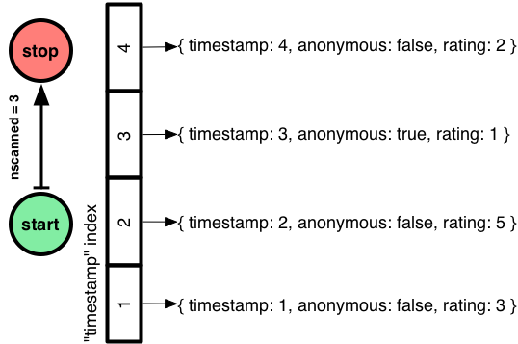
$sort, $limit, $skip
Sort documents by one or more fields
  Same order syntax as cursors
  Waits for earlier pipeline operator to return
  In-memory unless early and indexed
Limit and skip follow cursor behavior

Slide 30
Sort All the Documents in the Pipeline
{ title: “Great Gatsby, The” }
{ $sort: {title: 1} }
{ title: “Brave New World” }
{ title: “Animal Farm” }
{ title: “Grapes of Wrath” }
{ title: “Brave New World” }
{ title: “Animal Farm” }
{ title: “Great Gatsby” }
{ title: “Lord of the Flies” }
{ title: “Grapes of Wrath, The” }
{ title: “Lord of the Flies” }

Slide 31
Limit Documents Through the Pipeline
{ title: “Great Gatsby, The” }
{ $limit: 5 }
{ title: “Brave New World” }
{ title: “Great Gatsby, The” }
{ title: “Grapes of Wrath” }
{ title: “Brave New World” }
{ title: “Animal Farm” }
{ title: “Grapes of Wrath” }
{ title: “Lord of the Flies” }
{ title: “Animal Farm” }
{ title: “Fathers and Sons” }
{ title: “Lord of the Flies” }
{ title: “Invisible Man” }

Slide 32
Skip Documents in the Pipeline
{ title: “Great Gatsby, The” }
{ $skip: 3 }
{ title: “Brave New World” }
{ title: “Animal Farm” }
{ title: “Grapes of Wrath” }
{ title: “Lord of the Flies” }
{ title: “Animal Farm” }
{ title: “Fathers and Sons” }
{ title: “Lord of the Flies” }
{ title: “Invisible Man” }
{ title: “Fathers and Sons” }
{ title: “Invisible Man” }

Slide 33
$redact Example Data
{
_id: 375,
item: "Sony XBR55X900A 55Inch 4K Ultra High Definition TV",
Manufacturer: "Sony",
security: 0,
quantity: 12,
list: 4999,
pricing: {
security: 1,
sale: 2698,
wholesale: {
security: 2,
amount: 2300 }
}
}

Slide 34
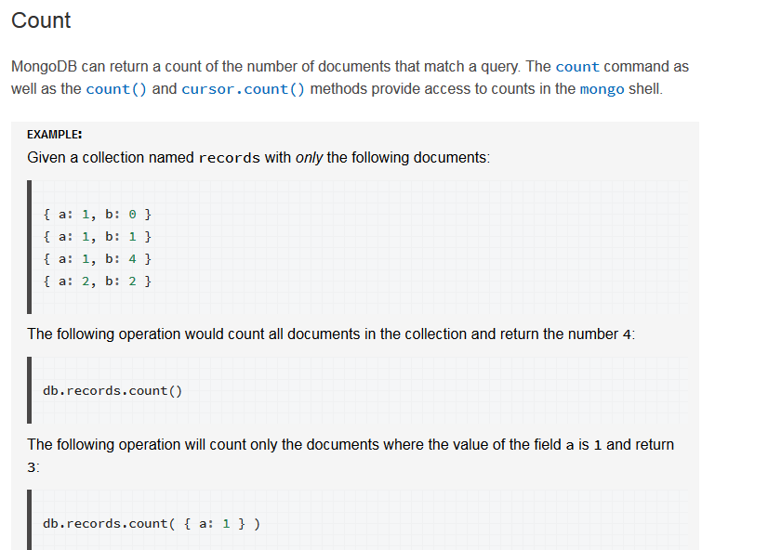
Single Purpose Aggregation Operations

Slide 35
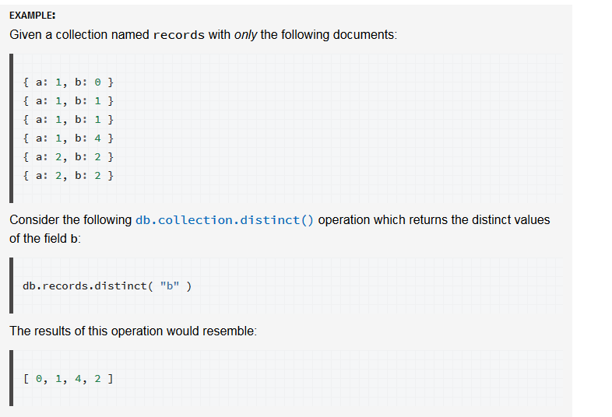
Single Purpose Aggregation Operations
Distinct
The distinct operation takes a number of documents that match a query and returns all of the unique values for a field in the matching documents.

Slide 36

Work on all the aggregation and its operators

Slide 37
Thank you for your attention!

